Slide 1
Radio Frequency (RF) Safety When Working Near Cellular Antennas
Wireline Field Technicians
January 2017

Slide 2
Contents / Agenda
Background - deployment of small cell antennas
Radio Frequency (RF) Hazard
RF Exposure
Tech Training
RF Monitor
Next Steps

Slide 3
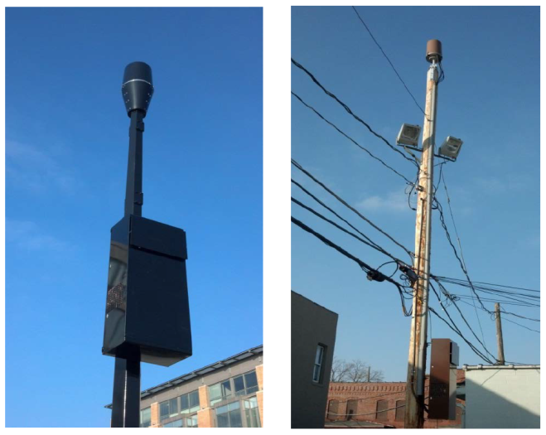
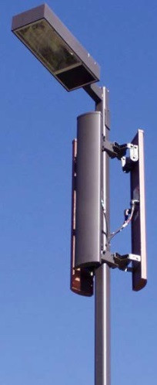
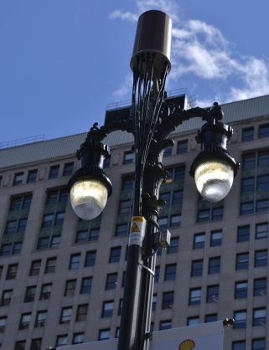
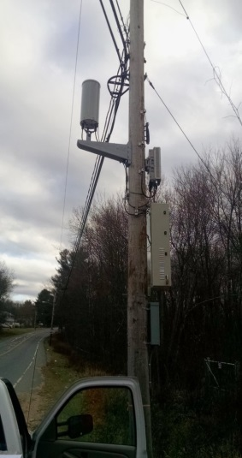
Background
Cellular companies are beginning to deploy antennas on utility poles (and other non-traditional structures)
Poles, light posts, billboards, buildings
“Densify” their network coverage
Verizon Wireless and other carriers
Pole owners have an obligation to grant space / access

Slide 4
RF Hazard
Cellular antennas use radio waves to transmit signals.
Radio waves are a form of electromagnetic energy and are referred to as "radio frequency" or "RF" energy or radiation
Prolonged exposure to RF energy can increase a person’s body temperature (by causing the atoms in your body vibrate faster)
Tissue damage may occur because of the body's limited ability to dissipate excessive heat
RF exposure effects are not cumulative
Multiple exposures do not add up…when exposure stops, any heating is dissipated
At low levels of exposure or short exposure times, where significant buildup of heat does not cause damage to tissues, temporary heating of tissues will not cause lasting effects.

Slide 5
RF Exposure
Three factors impact the amount of RF energy a person is exposed to:
Power level – how strong is the signal being transmitted from the antenna?
Distance – how close is someone to the antenna, the energy level dissipates quickly over distance
Time – how long is someone exposed to the RF energy
Permissible Exposure Limits (PEL)
The FCC has established two levels of PEL regarding RF radiation
General Population Limit – for those who may not be aware of the exposure
Occupational / Controlled Limit – for those who are aware of the hazard and can exercise control to limit their exposure

Slide 6
Wireline Field Ops Approach
Approve appropriate locations for deployment on poles
Not allowed on poles with hubs or cross-boxes
Locations with low level of tech activity are best
All outside technicians receive training
1Q2017
Awareness for all technicians
How to work in an RF environment
How to use the RF meter, alarming, when to exit the work area
Deploy Nardalert RF monitor – initial deployment underway, more to follow
When working in an RF environment
Utilize an RF meter
If necessary, request shut-down

Slide 7
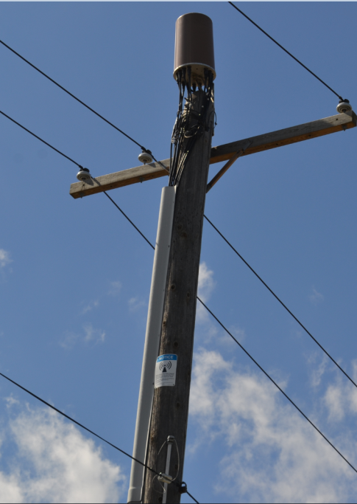
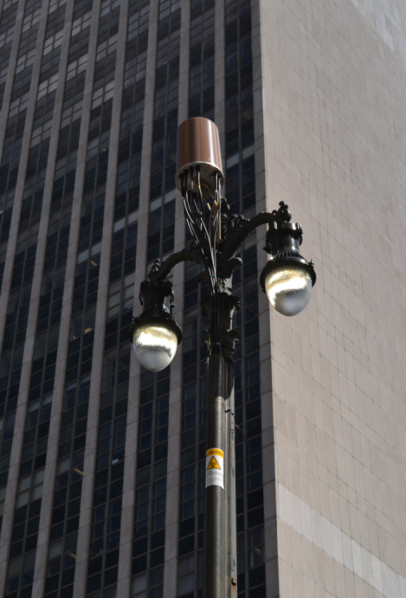
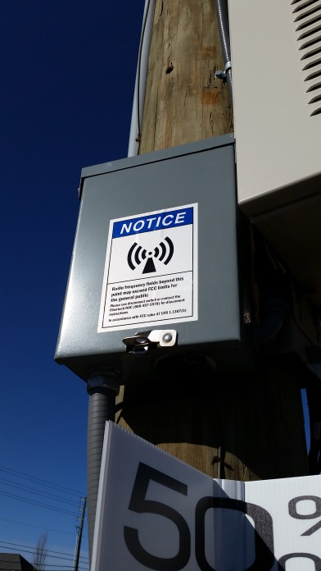
Pole Mounted Antennas
Three components
The transmitting antenna
Support equipment / electronics
Signage
Verizon employees are to strictly adhere to restrictions indicated by RF signage unless equipped with an RF meter so that they can monitor and control their amount of RF exposure.

Slide 8
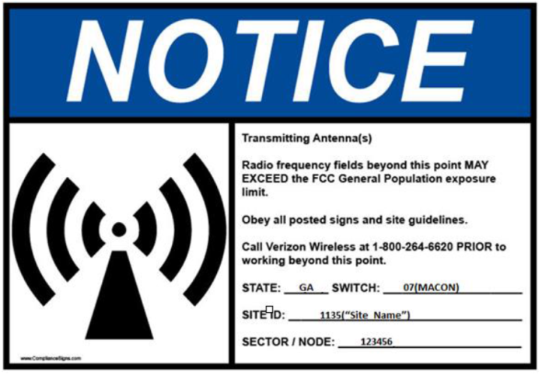
Contacting the Carrier NOC
Contact all wireless carriers directly should work need to be performed within the posted separation distance or restricted RF area (where RF levels exceed the General Public Limits).
Arrange for the antenna to be temporarily powered down before work can begin.
Verizon Wireline personnel will not be permitted to power down any antennas directly, the carrier will be required to power down any antennas
The contact number for the carrier is listed on the RF warning stickers or on the NOC sticker.
When arranging for an antenna to be shutdown, the Carrier NOC will require the information listed on the sticker to identify the antenna.

Slide 9
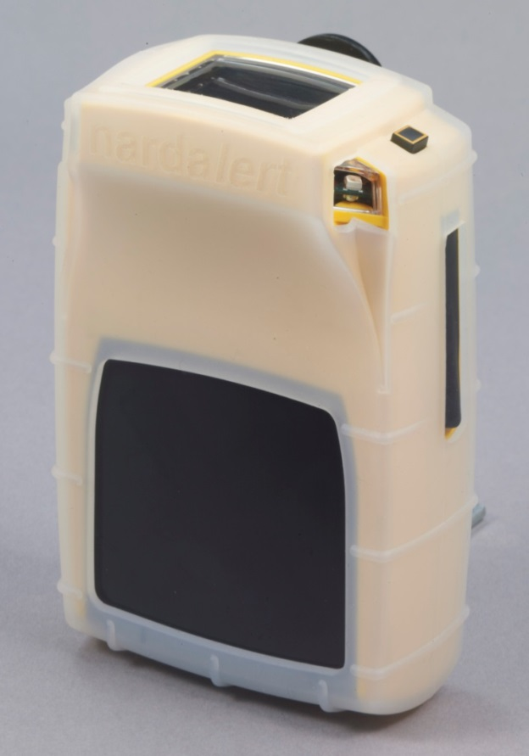
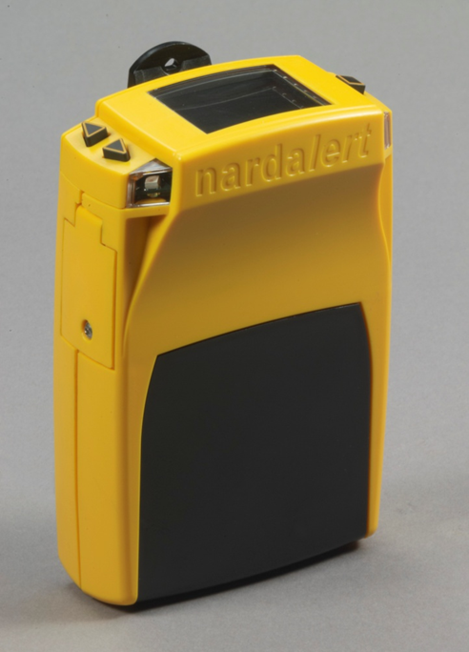
Nardalert S3
Simple to use – Just turn it on and it is ready for use
Pre-configured according to Verizon specifications
Options menus are locked, as there is nothing to adjust
The up and down arrow menu buttons are not functional, except to turn on the display backlight.
Color LCD Display
On/Off Button
Menu Buttons
Multi-Color Alarm LED’s
Battery Compartment
USB Interface For Charging.
Replaceable Sensor Module
Protective Silicon Skin

Slide 10
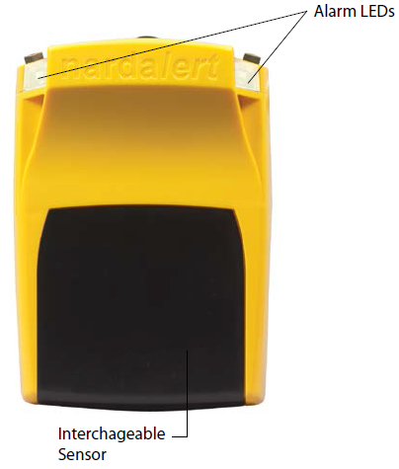
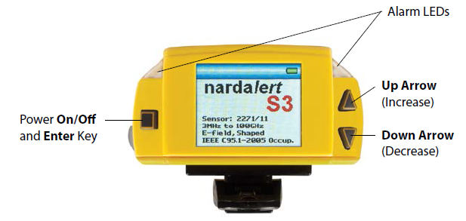
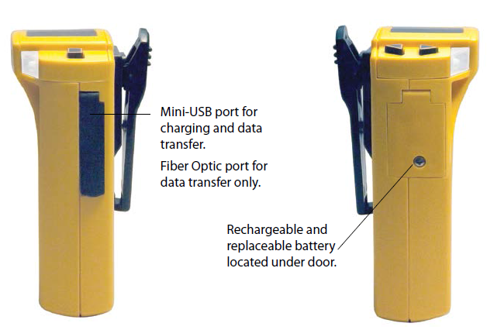
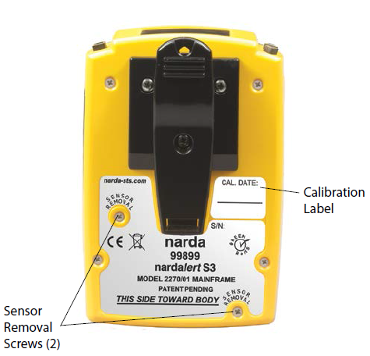
Nardalert S3

Slide 11
Next Steps
Complete tech training – target for 1Q17
Narda rep training
Specific request from New England but we will extend to all areas
Additional RF meters to field
As needed based on scale of cell site deployment
Coordination with industry standards and power companies

Slide 12
Resources
VZ Learn
VZ95377VZ74705
FCC link needed
https://www.fcc.gov/general/radio-frequency-safety-0

